Slide 1
03 Temporal Difference Method

Slide 2

This tutorial is mainly contributed by…
Github
方泽鸣，zemingfang11@gmail.com
张洳源，ruyuanzhang@gmail.com
张洁莹，jieying.zhang@student.uva.nl
部分内容由张洳源老师正在编写的教材《认知行为的计算原理》收录： https://ruyuanzhang.gitbook.io/compmodcogpsy

Slide 3
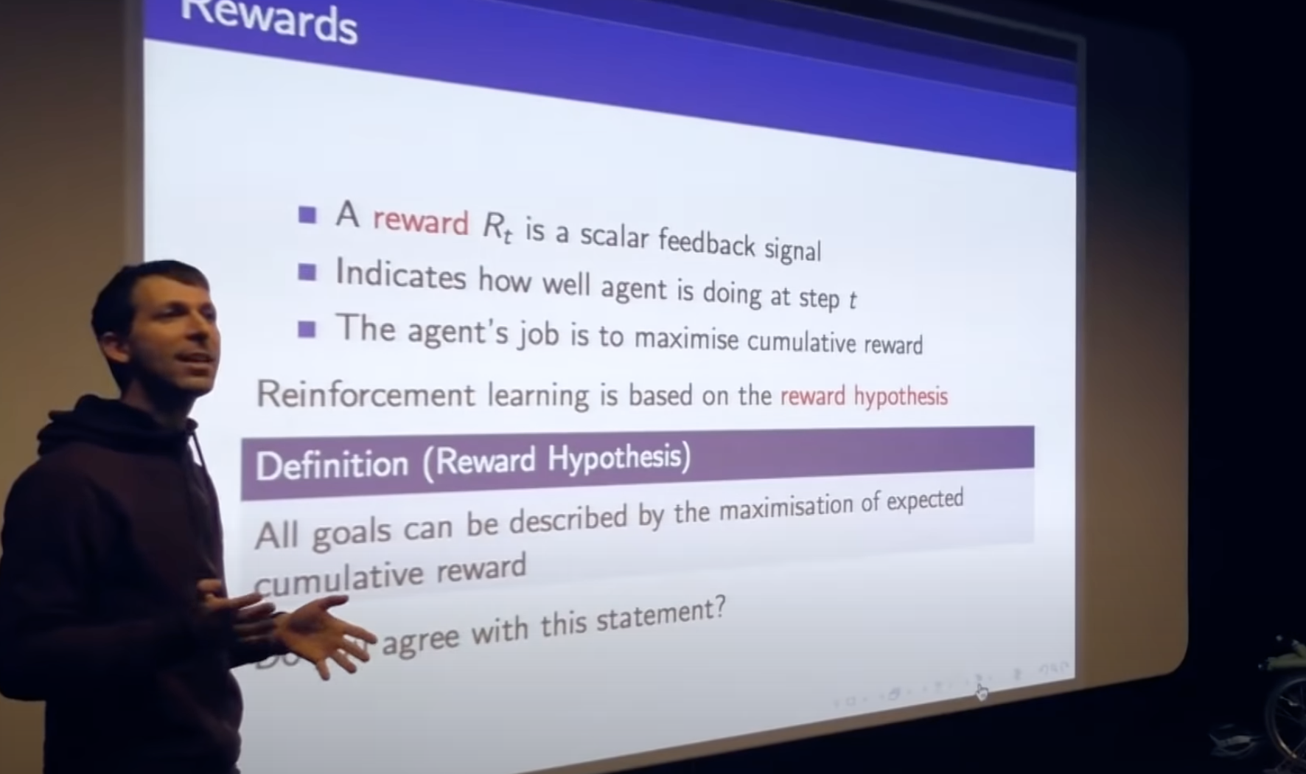
Goal: reward hypothesis

Slide 4
Definition:
Goal:
Model-based
Model-free
A lack of model
Dynamic Programming
Monte Carlo Method
Policy iteration
Value iteration

Slide 5
Overview
Lecture
Monte Carlo control
Temporal Difference prediction
Temporal Difference control
Practice MC control
Sarsa
Q learning

Slide 6
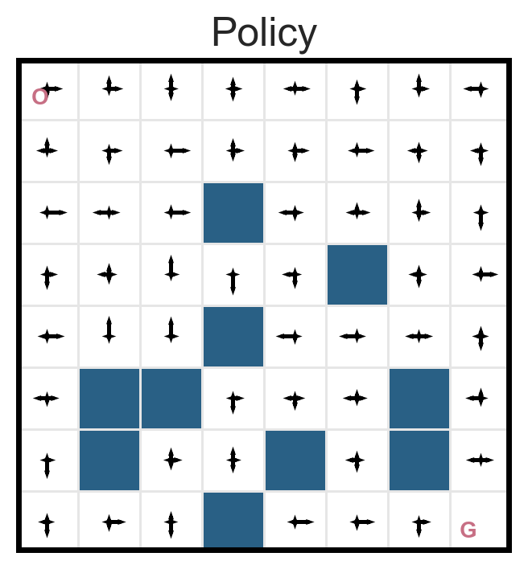
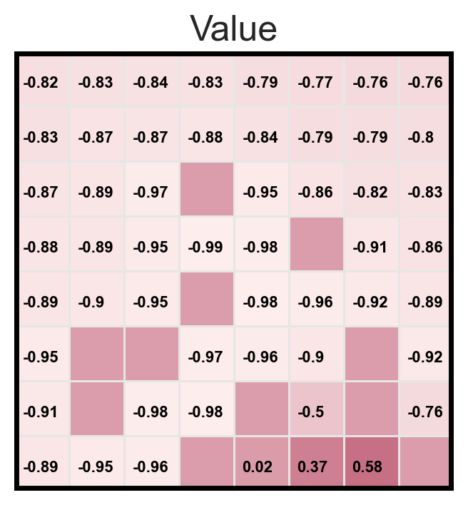
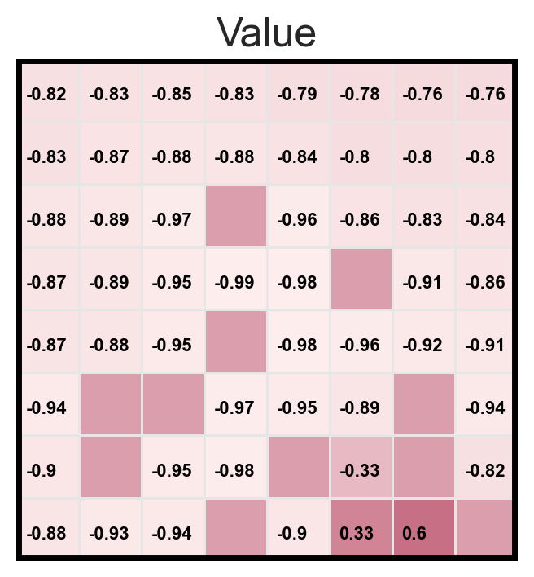
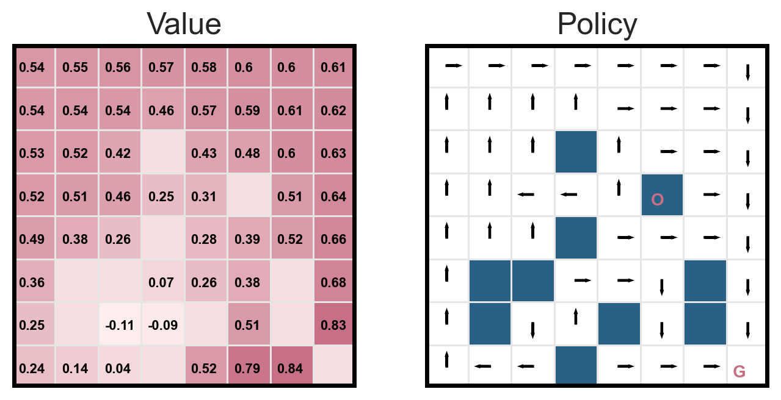
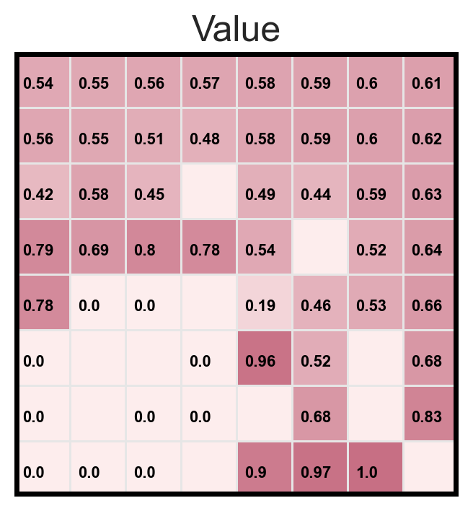
Policy evaluation vs. MC prediction
Policy evaluation
MC prediction
Random policy
Optimal policy
Exploration and exploitation

Slide 7
Overview
Lecture
Monte Carlo control
Temporal Difference prediction
Temporal Difference control
Practice
MC control
Sarsa
Q learning

Slide 8
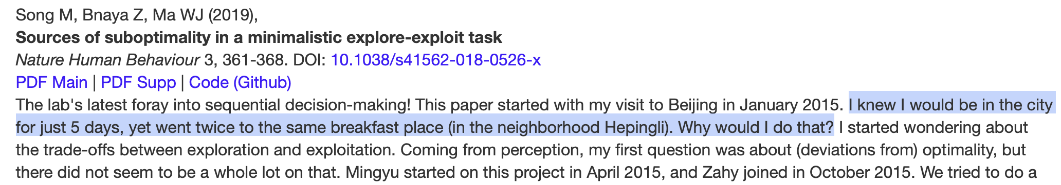
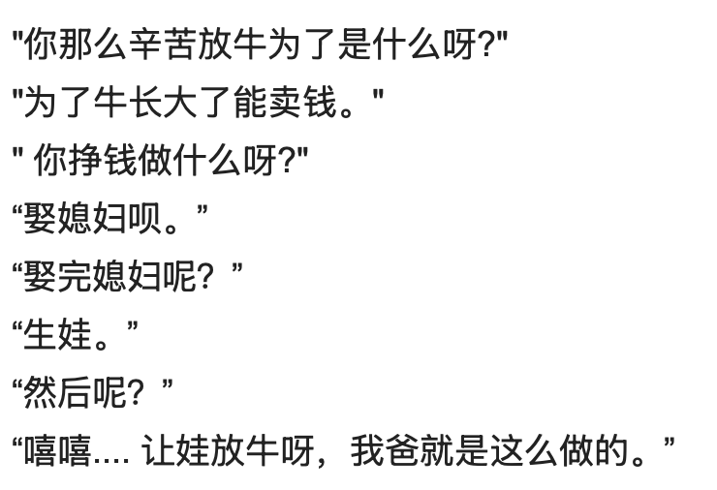
Exploration-exploitation dilemma
The optimality should be based on the correct understanding (value evaluation) of the surrounding environment.

Slide 9
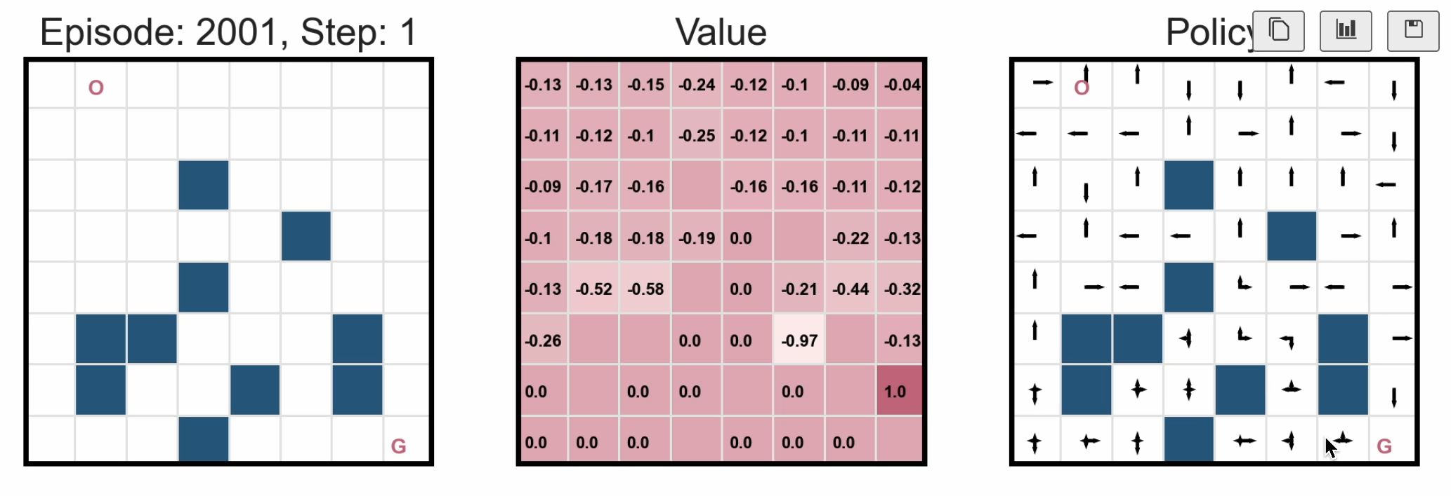
When there is no exploration..

Slide 10
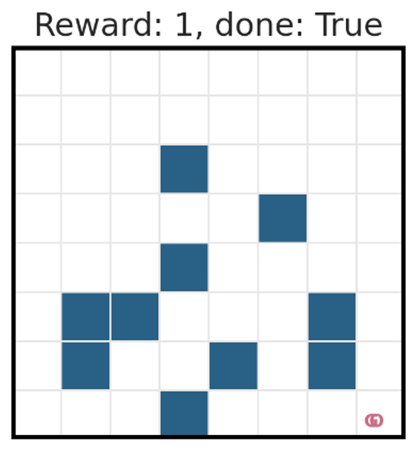
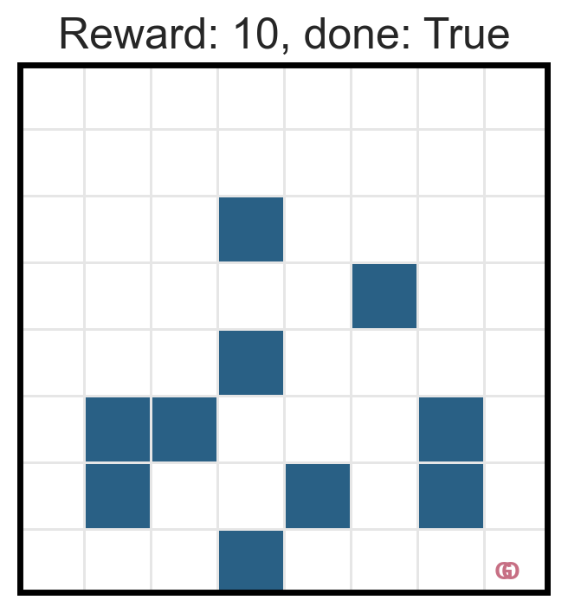
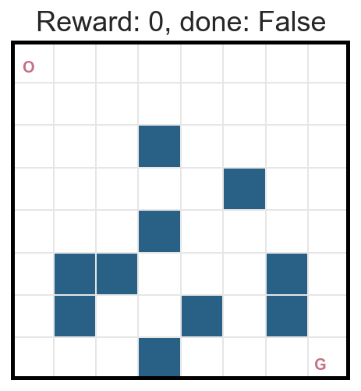
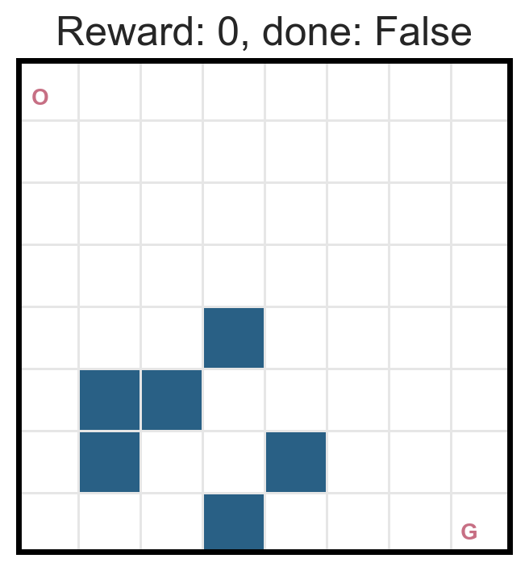
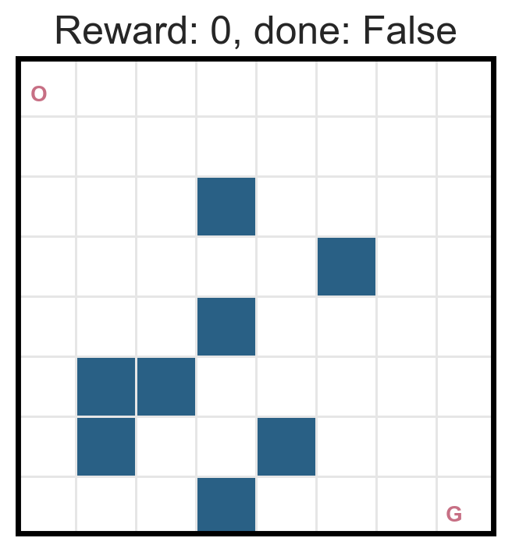
MC method is not an efficient algorithm…
We need to make a few modifications…
使探索得以发生
1. Increased the reward
2. Simplified the layout

Slide 11
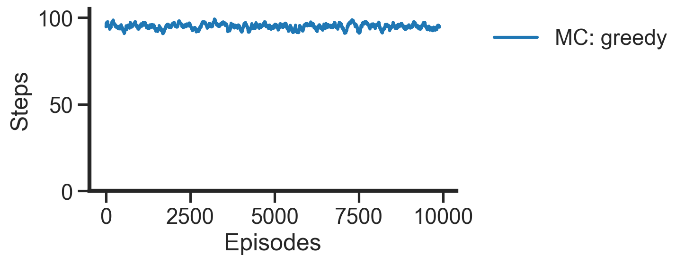
When there is no exploration..
Smoothed by averaging in a window size=100

Slide 12
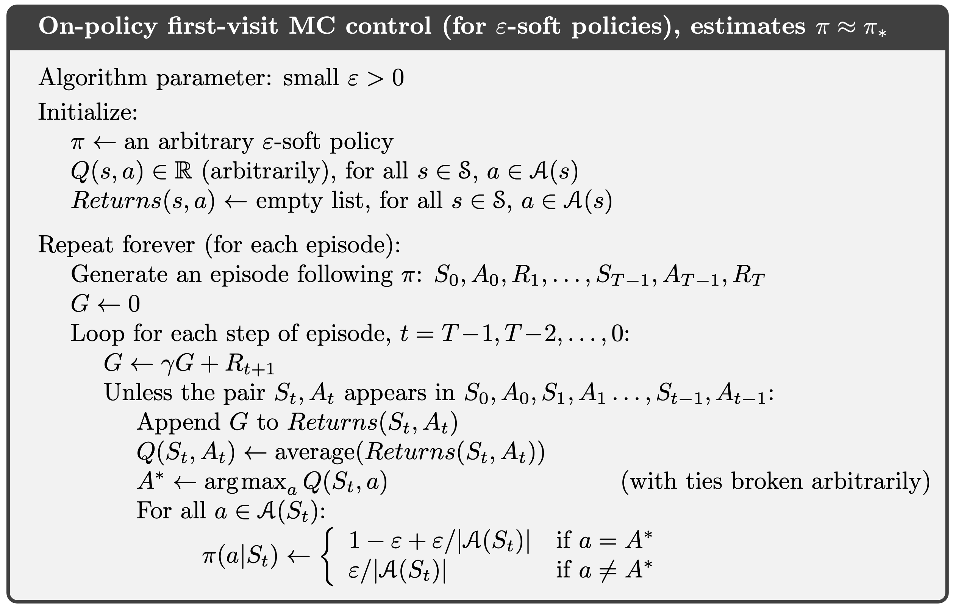
#Practice: MC control with epsilon-greedy
保证探索的均衡

Slide 13
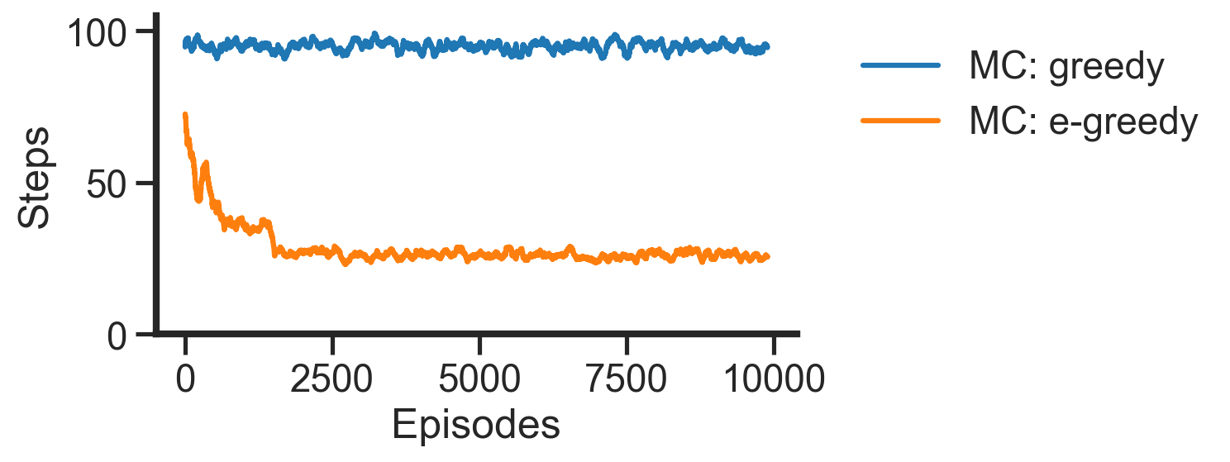
MC control with epsilon-greedy

Slide 14
Any room for improvement?

Slide 15
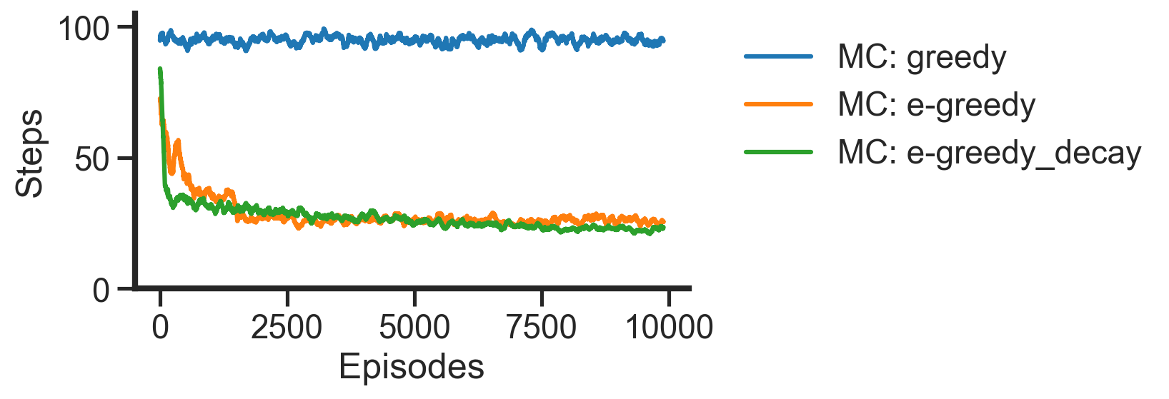
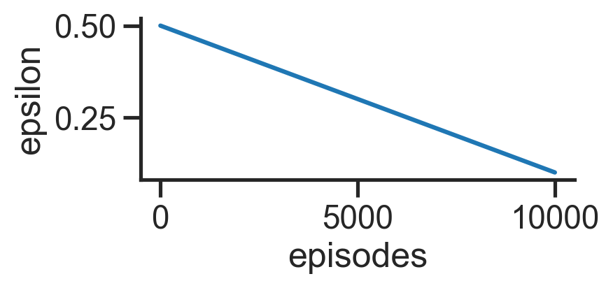
Epsilon-greedy with decay epsilon

Slide 16
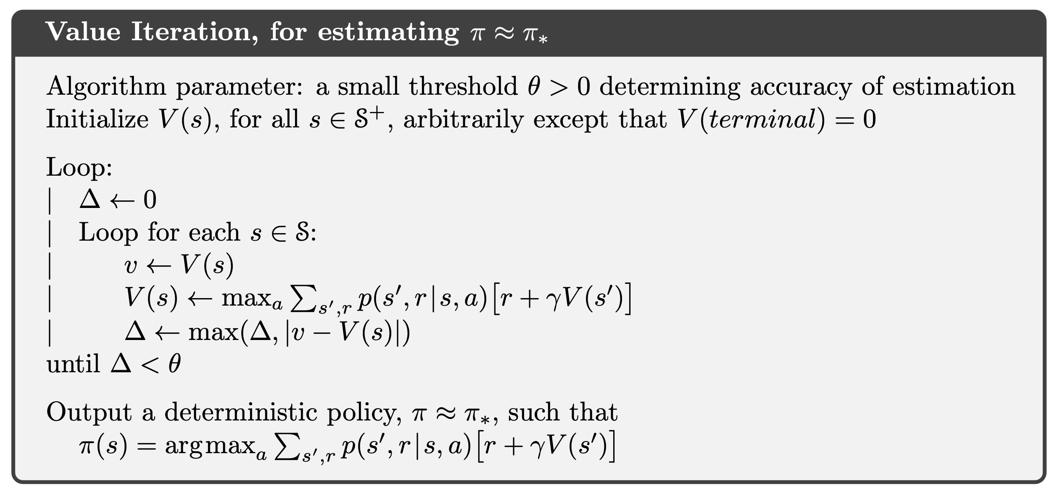
Why “exploration” was not mentioned before?

Slide 17
Overview
Lecture
Monte Carlo control
Temporal Difference prediction
Temporal Difference control
Practice MC control
Sarsa
Q learning

Slide 18
Accelerate the MC method
Policy evaluation
Policy improvement
Value iteration
MC prediction
MC control
??

Slide 19
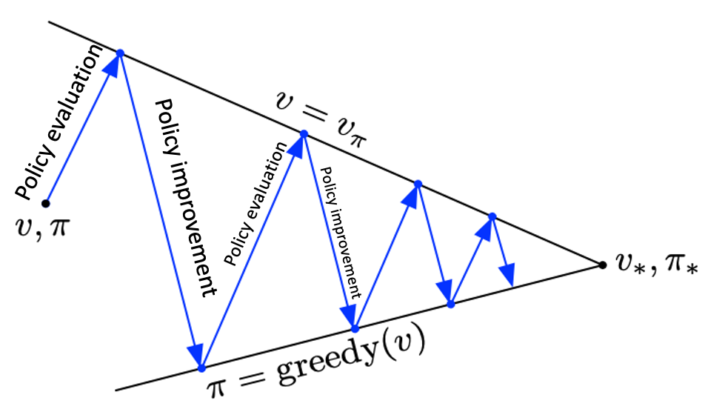
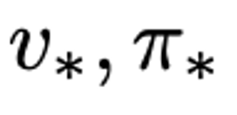
Value iteration
Policy Iteration
Value Iteration

Slide 20
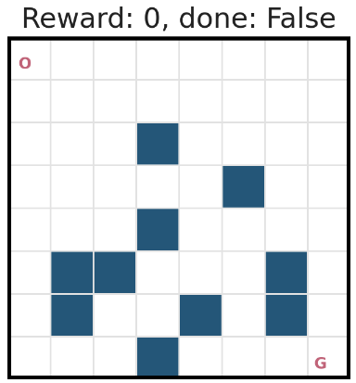
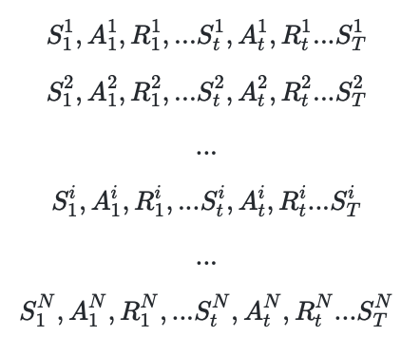
Accelerate the MC method

Slide 21



Temporal Difference method

Slide 22
Temporal Difference method
Online Learning
Human Learning

Slide 23

Temporal Difference method
Not an accurate approximation, as N = 1, not
$$∞$$

Slide 24
Temporal Difference method

Slide 25
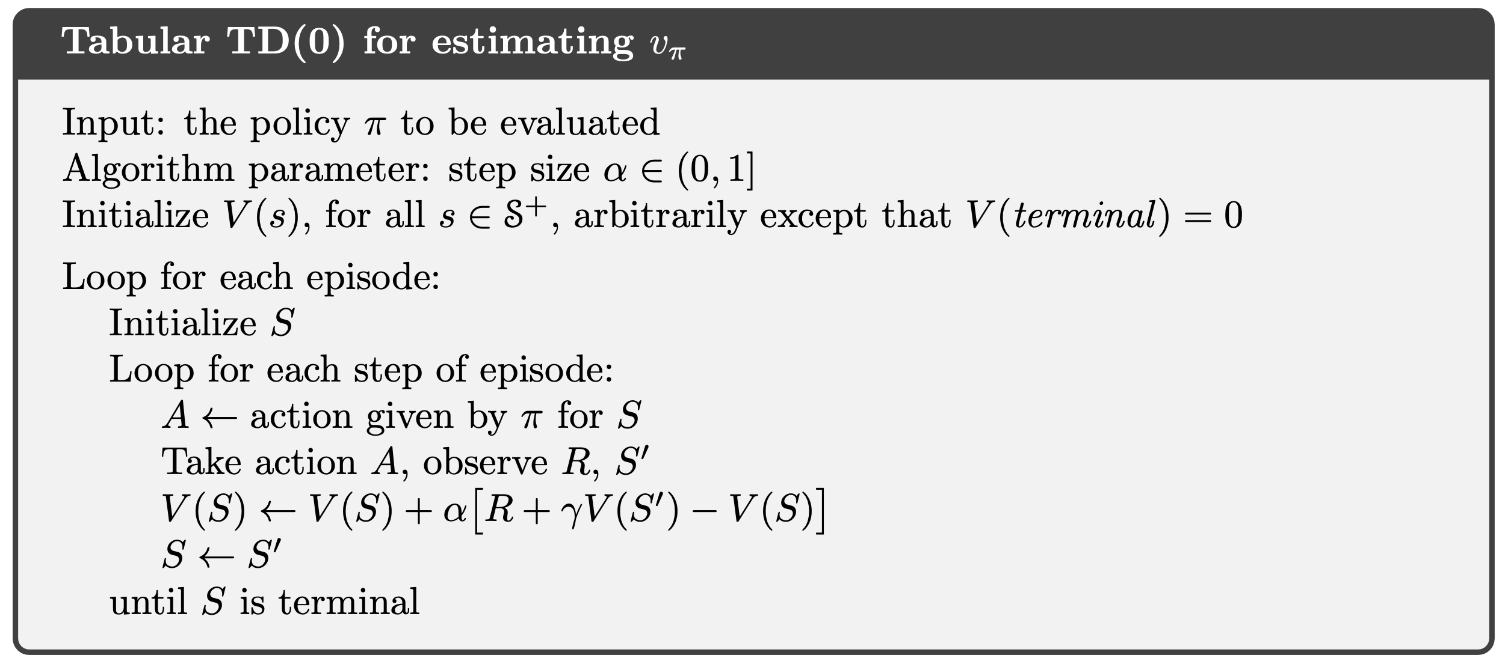
Temporal Difference prediction

Slide 26
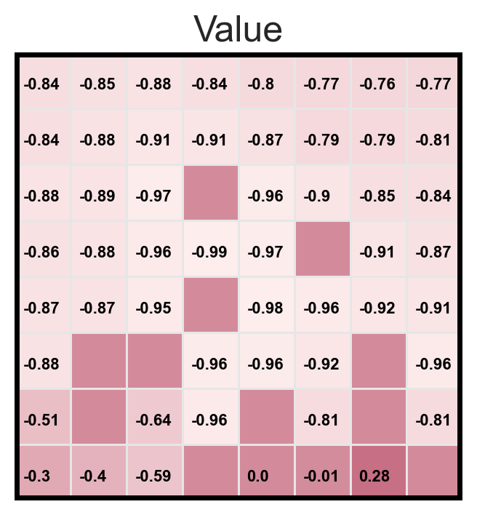
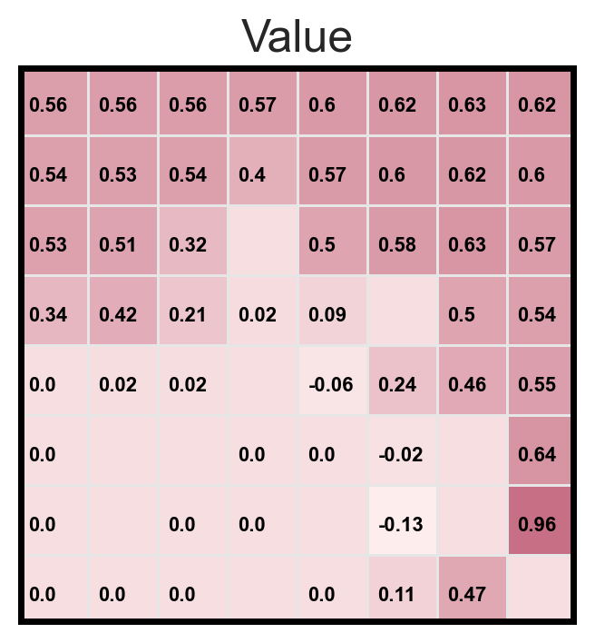
Policy evaluation vs. MC prediction
Policy evaluation
MC prediction
TD prediction
Random policy
Optimal policy

Slide 27
Overview
Lecture
Monte Carlo control
Temporal Difference prediction
Temporal Difference control
Practice MC control
Sarsa
Q learning

Slide 28
More TD variants
Q-learning
Sarsa
都是错的近似方法，但是方向都是对的。期望转变为采样

Slide 29
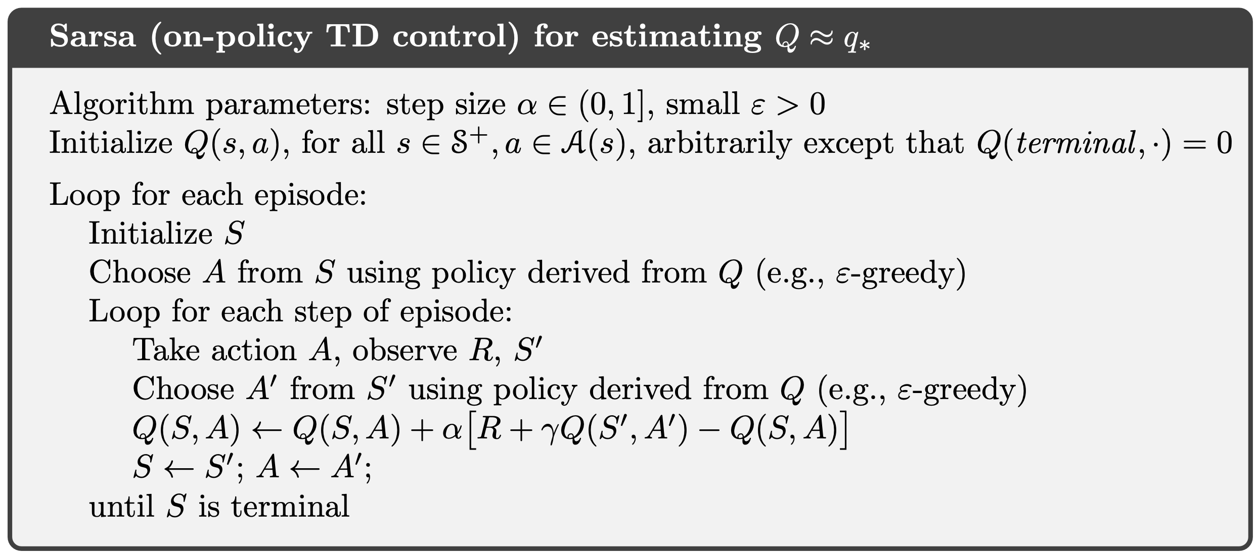
#Practice: Sarsa
优化目标和计算方向来自于同一个policy
On-policy

Slide 30
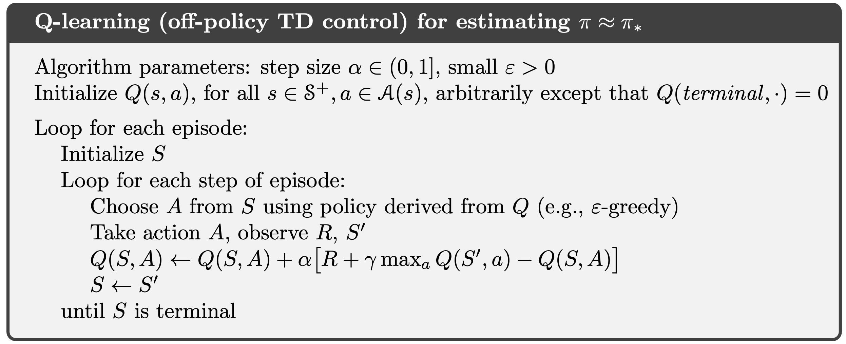


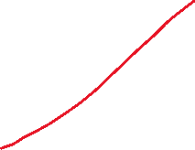

#Practice: Q learning
greedy和ε-greedy
Off-policy

Slide 31
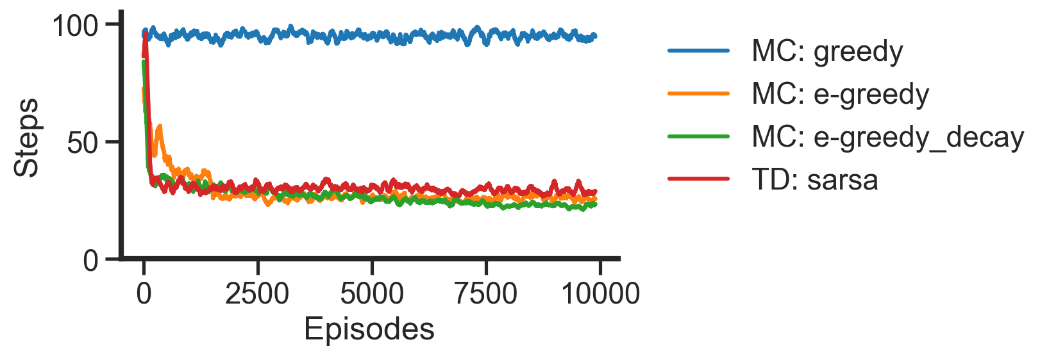
The performance of TD controls

Slide 32
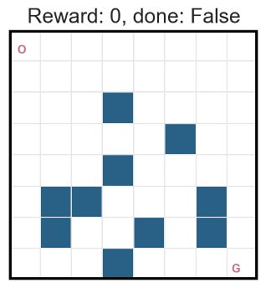
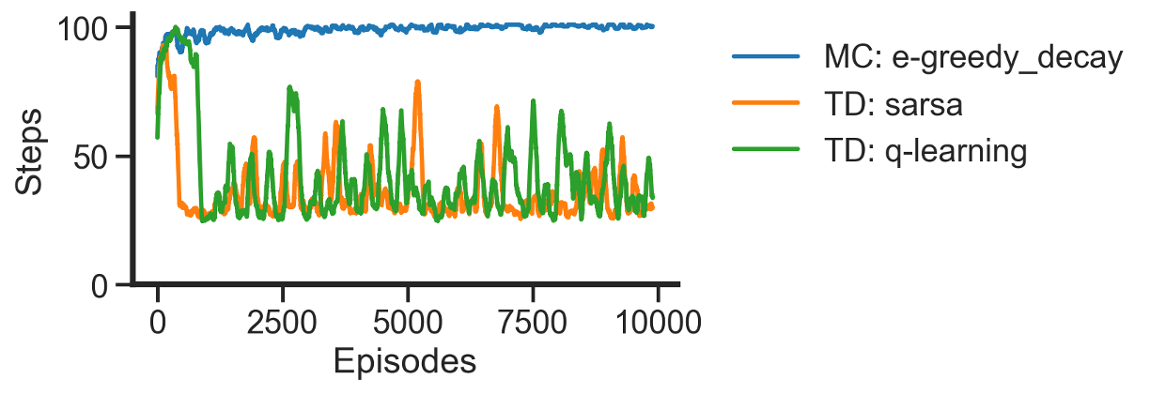
TD method is much more powerful than the MC
危险环境完全没法学！
波动是由于滑动导致的

Slide 33
Definition:
Goal:
Model-based
Model-free
A lack of model
Dynamic Programming
Monte Carlo Method
Policy iteration
Value iteration
Online learning
Temporal Difference Method
Sarsa
Q learning

Slide 34
Overview
Lecture
Monte Carlo control
Temporal Difference prediction
Temporal Difference control
Practice MC control
Sarsa
Q learning

